Slide 1
SOCIAL MEDIA
By Islam Lotfy

Slide 2
Our agenda
Introduction to social media and in depth
The merits and demerits of social media
The different types of social media
Questions

Slide 3
Introduction to social media
Social media is becoming an essential part of education so let us discuss the advantages and disadvantages of using Social media in our lives in the short and long term. I agree with this assertion discussing media adds a positive impact on people

Slide 4
social media In depth
Social media are interactive technologies that facilitate the creation and sharing of information, ideas, interests, and other forms of expression through communities and networks
People use social media to stay in touch and interact with friends, family, and various communities. Businesses use social applications to market and promote their products and track customer concerns.

Slide 5
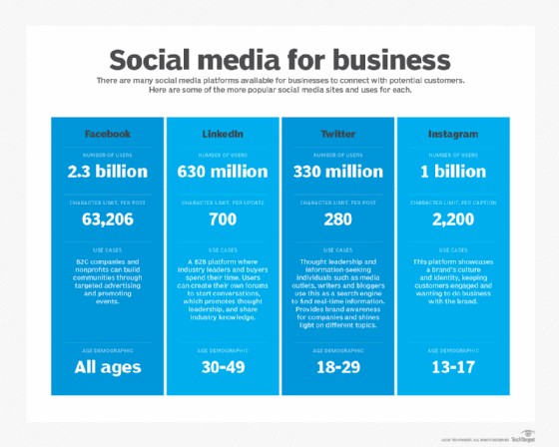
The merits and demerits of social media
Social media has a huge base globally. Mobile applications make these platforms easily accessible. Some popular examples of general social media platforms include Twitter, Facebook , and LinkedIn.

Slide 6
Facts of social media
LinkedIn has over 70 million members in over 200 countries.
A new member joins LinkedIn approximately every second, and about half of our members are outside the U.S Source: Linked-In
More than 500 million active Facebook users
50% of active users log on to Facebook on any given day
People spend over 700 billion minutes per month on Facebook

Slide 7
Merits
User visibility. Social platforms let people easily communicate and exchange ideas or content.
Business and product marketing. These platforms enable businesses to quickly share their products and services with a broad audience
Audience building. Social media has eliminated the need for a distributor because anyone can upload their content online to their network of friends, who share it on their networks.

Slide 8
Demerits
The overuse of social apps can result in burnout, social media addiction, and other issues.
False information can be spread quickly
Social interaction, whether online or in person, can affect employees' productivity.

Slide 9
The different types of social media
Social networks. People use these networks to connect with one another and share information on Facebook and LinkedIn are good examples.
Media-sharing networks. These networks focus on content. For example, on YouTube, TikTok, and Instagram. Streaming platforms
Review board networks. With these networks, the focus is on a review, usually of a product or service.

Slide 10
Questions

Slide 11
Resources
https://www.techtarget.com/whatis/definition/social-media
https://en.wikipedia.org/wiki/Social_media
https://www.linkedin.com/

